Slide 1

DIGITAL CAMPUS:
STRENGTHENING OF THE PROFESSIONAL PRESENTATION IN EMPLOYMENT OFFICES

Slide 2


OBJECT
Innovation in the Employment Public Services attention, strengthening the professional presentation of new recruitment processes in the labour market, improving competences.
PARTICIPANTS
Service demanders registered in the Employment Public Service in the Comunidad de Madrid.

Slide 3
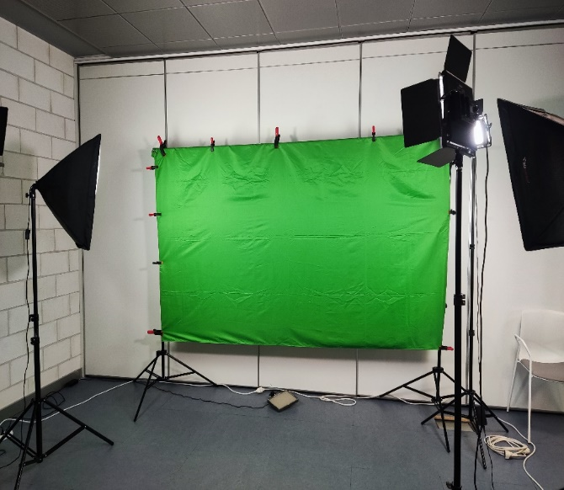
DIGITAL CAMPUS ACTIONS
JOBSEEKERS ORIENTATION:
  CV review.
  Professional competences.
  Personal brand/Social networks.
  Jobseekers links.
2. VIDEO CV, INTERVIEW SIMULATION AND PROFESSIONAL PHOTO:
  Use of Chroma Space or Green Screen.

Slide 4
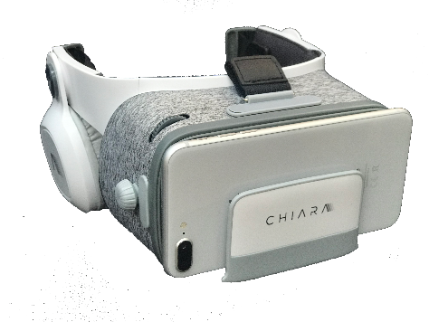
DIGITAL CAMPUS ACTIONS
3. METAVERSE KNOWLEDGE: VIRTUAL REALITY GLASSES (RV): SELECTION INTERVIEW EXPERIENCE.
  Simulator based in Coach virtual to improve communication skills.
  Use of Artificial Intelligence and advanced thecnologies in natural language analysis.
  Virtual environment selection.
  Real environments and characters recorded in 360º.

Slide 5
DIGITAL CAMPUS ACTIONS
3. METAVERSE KNOWLEDGE: VIRTUAL REALITY GLASSES (RV): SELECTION INTERVIEW EXPERIENCE.
  Receiving individualised feedback with guidelines for improvement:
    Verbal communication: voice, quality, positivity, silences, pet words…
    Visual contact: Heat maps, eye contact management, length.
    Paraverbal communication: intonation, speed and volume.

Slide 6
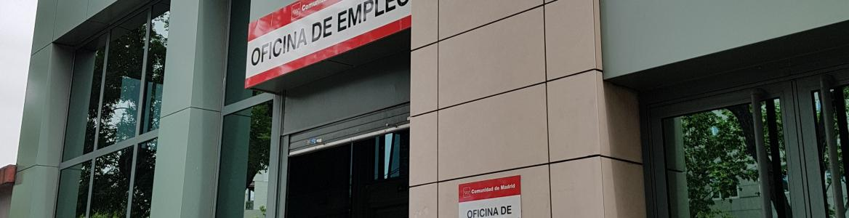
DIGITAL CAMPUS: MAIN DATA EXPERIENCE
Carried out in Vallecas Employment Office: new model of Employment Office.
Dates of completion: June and September 2023.
Planned editions: 16.
Expected participants: 160.
Very well received among participants.

